Slide 1
COLLEGE CHATBOT
CAPSTONE PROJECT
Presented By:
1. AANANTHI N-THIAGARAJAR COLLEGE OF ENGINEERING-IT

Slide 2
OUTLINE
Problem Statement (Should not include solution)
Proposed System/Solution
System Development Approach (Technology Used)
Algorithm & Deployment
Result
Conclusion
Future Scope
References

Slide 3
Problem Statement
The current communication and information retrieval systems in our college are outdated and do not effectively cater to the dynamic needs of the academic community. Students, faculty, and staff often face difficulties in accessing essential information, obtaining quick responses to queries, and navigating through the students Presepective

Slide 4
Proposed Solution
To address these issues, we propose the development of an intelligent chatbot designed to assist students with their queries in real-time. This chatbot will be integrated into the college's existing digital platforms, such as the official website and mobile application. The chatbot will leverage natural language processing (NLP) to understand and respond to student inquiries accurately and promptly. It will provide information on various topics, including academic schedules, course details, event updates, and administrative processes.

Slide 5
System Approach
The development of the chatbot will involve several key technologies:
Natural Language Processing (NLP): To understand and process student queries.
Machine Learning (ML): To improve the chatbot's responses over time through learning algorithms.
Cloud Computing: For scalable deployment and easy integration with existing college systems.
Database Management Systems (DBMS): To store and retrieve information efficiently.
APIs (Application Programming Interfaces): To connect the chatbot with external systems such as the college's information management system.

Slide 6
Algorithm & Deployment
The chatbot will be built using the following algorithmic steps:
Query Processing: Using NLP techniques to parse and understand the student's query.
Intent Recognition: Determining the intent behind the query using machine learning models.
Information Retrieval: Accessing the relevant database to fetch the required information.
Response Generation: Crafting an appropriate response using predefined templates and dynamic data.
Learning & Adaptation: Continuously improving the chatbot's accuracy through feedback loops and supervised learning.
Deployment will be carried out on a cloud platform to ensure scalability and accessibility. The chatbot will be integrated with the college's website and mobile app through APIs.

Slide 7
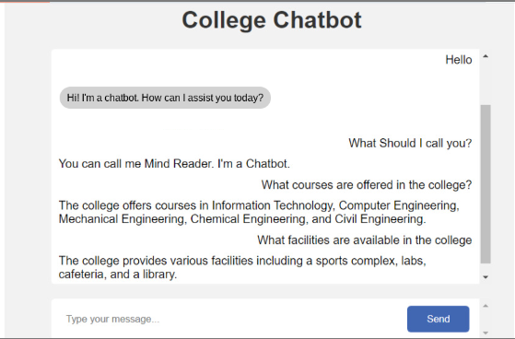
Result
Upon deployment, the chatbot is expected to significantly reduce the workload on administrative staff by handling common student inquiries. It will provide students with immediate access to information, thus enhancing their overall experience. The system's efficiency and effectiveness will be measured through user feedback, query response times, and the accuracy of provided information.

Slide 8
Conclusion
The implementation of a college chatbot represents a significant step towards modernizing the student support system. By leveraging advanced technologies such as NLP and ML, the chatbot can provide real-time assistance to students, improving their access to information and overall satisfaction. The system not only benefits students but also optimizes administrative operations.

Slide 9
Future scope
Future enhancements for the chatbot may include:
Multilingual Support: To cater to a diverse student population.
Voice Recognition: For hands-free interaction with the chatbot.
Integration with Learning Management Systems (LMS): To provide personalized academic assistance.
Advanced Analytics: To gain insights into student needs and improve services.
AI-Driven Predictive Capabilities: To anticipate student queries and proactively provide information.

Slide 10
References
Jurafsky, D., & Martin, J. H. (2019). Speech and Language Processing (3rd ed.). Pearson.
Russell, S. J., & Norvig, P. (2020). Artificial Intelligence: A Modern Approach (4th ed.). Pearson.
Chollet, F. (2017). Deep Learning with Python. Manning Publications.
Dean, J., & Ghemawat, S. (2004). "MapReduce: Simplified Data Processing on Large Clusters". Proceedings of the 6th Symposium on Operating Systems Design and Implementation.
Goodfellow, I., Bengio, Y., & Courville, A. (2016). Deep Learning. MIT Press.

Slide 11
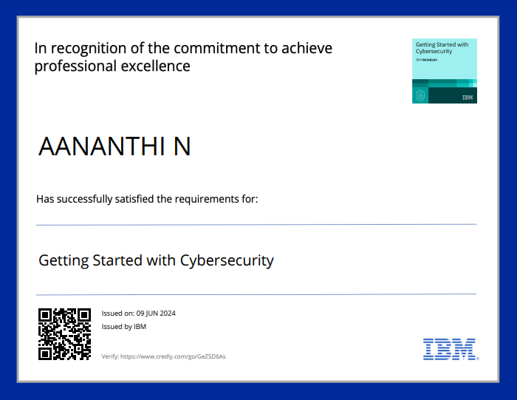
course certificate 1

Slide 12
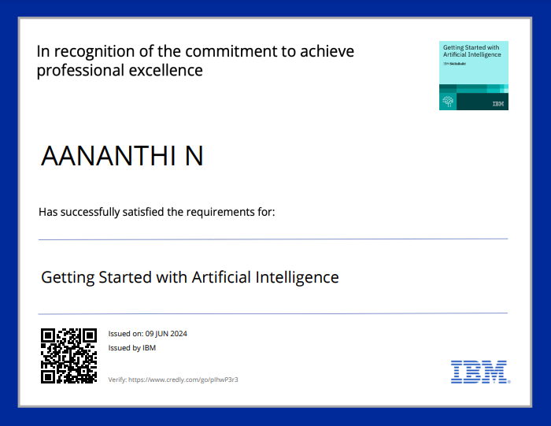
course certificate 2

Slide 13
THANK YOU

